Slide 1
Unsupervised Learning
Tomas Karpati MD tc.datascience@gmail.com
054-2002430

Slide 2
Unsupervised Learning
Statistical Learning
Use of the data to derive a statistical / mathematical model that can describe or predict it.
There are two modalities:
Supervised Learning
Unsupervised Learning

Slide 3
Unsupervised Learning
Supervised Learning
Model generation driven by the outcome (dependent variable)
Unsupervised Learning - Cluster Analysis
When we have data and we do not have an outcome (dependent variable) that classifies the data, we try to search for patterns in the data that can help in classes generation.

Slide 4
Unsupervised Learning
Unsupervised Learning - Cluster Analysis
Customer Segmentation
Risk behaviour
Customer value
Loyal customers
Fraud detection
Individualized recommendations
Grouping patterns - markets, genes, posts, books, movies

Slide 5
Unsupervised Learning
Unsupervised Learning
Cluster analysis
Partitioning or Centroid-based clustering (k-means, k-medoids)
Connectivity-based clustering (hierarchical clustering)
Distribution-based clustering
Density-based clustering (DBSCAN)

Slide 6
Cluster Analysis
Centroid Based
k-means
Connectivity Based
Minimize Intra-cluster distance
Distribution Based
Maximalize Inter-cluster distance
Density Based

Slide 7
Cluster Analysis
k-means
Centroid Based
Step 1 - Determine the number of clusters: k = 3
Step 2 - Select a random point for each cluster and assign it as a center
Connectivity Based
Distribution Based
Density Based

Slide 8
Cluster Analysis
k-means
Centroid Based
Step 1 - Determine the number of clusters: k = 3
Step 2 - Select a random point for each cluster and assign it as a center
Connectivity Based
Step 3 - Calculate the distances for each point to each of the centers and assign to the lowest distance center
Distribution Based
Density Based

Slide 9
Cluster Analysis
k-means
Centroid Based
Step 1 - Determine the number of clusters: k = 3
Step 2 - Select a random point for each cluster and assign it as a center
Connectivity Based
X
X
Step 3 - Calculate the distances for each point to each of the centers and assign to the lowest distance center
Distribution Based
X
Step 4 - Calculate the mean (center) of each group and repeat step 3
Density Based

Slide 10
Cluster Analysis
k-means
Centroid Based
Step 1 - Determine the number of clusters: k = 3
Step 2 - Select a random point for each cluster and assign it as a center
Connectivity Based
X
X
Step 3 - Calculate the distances for each point to each of the centers and assign to the lowest distance center
Distribution Based
X
Step 4 - Calculate the mean (center) of each group and repeat step 3
Density Based

Slide 11
Cluster Analysis
k-means
Centroid Based
Step 1 - Determine the number of clusters: k = 3
Step 2 - Select a random point for each cluster and assign it as a center
Connectivity Based
X
X
Step 3 - Calculate the distances for each point to each of the centers and assign to the lowest distance center
Distribution Based
X
Step 4 - Calculate the mean (center) of each group and repeat step 3
Density Based

Slide 12
Cluster Analysis
k-means
Centroid Based
Step 1 - Determine the number of clusters: k = 3
Step 2 - Select a random point for each cluster and assign it as a center
Connectivity Based
X
X
Step 3 - Calculate the distances for each point to each of the centers and assign to the lowest distance center
Distribution Based
X
Step 4 - Calculate the mean (center) of each group and repeat step 3
Density Based

Slide 13
Cluster Analysis
Hierarchical Clustering
Centroid Based
A
A
Connectivity Based
D
D
F
Distance
B
F
Distribution Based
B
E
E
C
C
Density Based
A B C D E F

Slide 14
Cluster Analysis
Centroid Based
Distance calculation methods:
Euclidian (√∑(x_{i} - y_{i})²)
Maximum ( max(x_{i} - y_{i}) )
Manhattan ( ∑|(x_{i} - y_{i})| )
Canberra (∑(|x_{i} - y_{i}|/|x_{i} + y_{i}|))
Minkowski ( (∑|(x_{i} - y_{i})|^{p})^{1/p} )
Connectivity Based
Distribution Based
Density Based

Slide 15
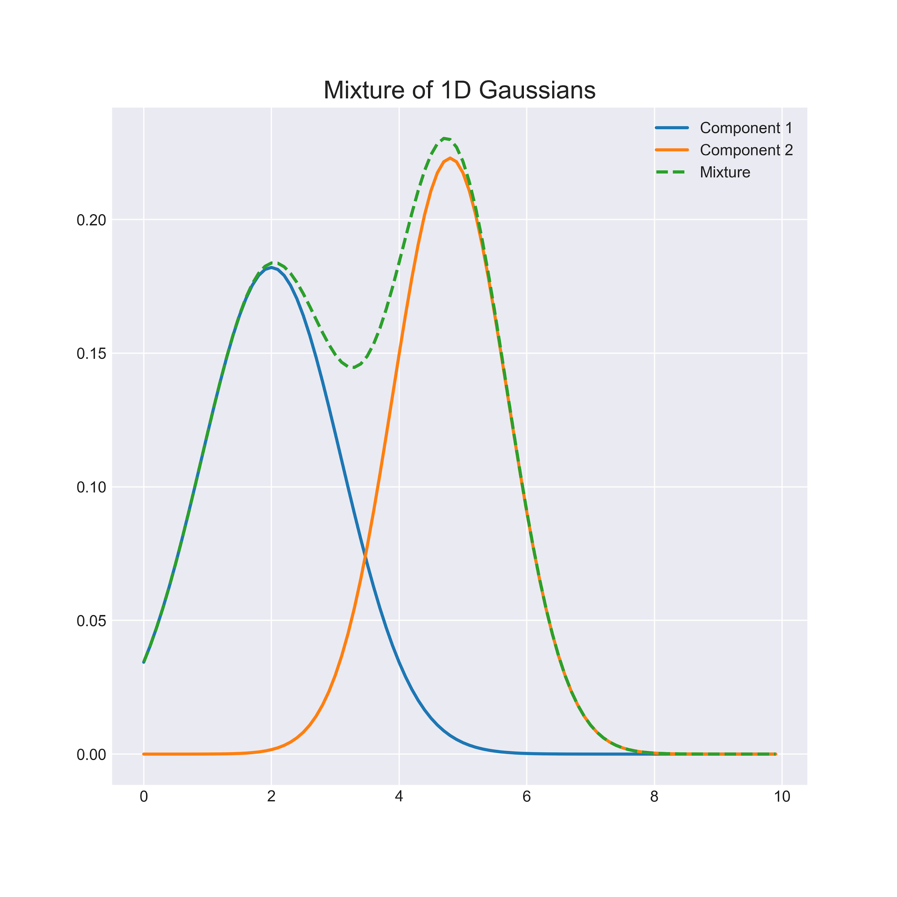
Cluster Analysis
Distribution / Model based clustering
Expectation-Maximization (EM) models
Gaussian Mixture Models
Centroid Based
Connectivity Based
Distribution Based
Density Based

Slide 16


Cluster Analysis
Expectation-Maximization model
Based on probabilistic (bayesian) models
Expectation phase
Randomly select k objects as cluster centers
Calculate the probability of each point to be in each cluster
Maximization step
Re-estimate model parameters
Centroid Based
Connectivity Based
Distribution Based
Density Based

Slide 17
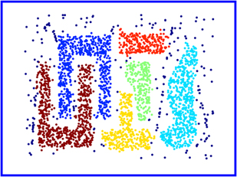
Cluster Analysis
Density-Based Spatial Clustering of Applications with Noise (DBSCAN)
Centroid Based
Connectivity Based
Distribution Based
Density Based

Slide 18
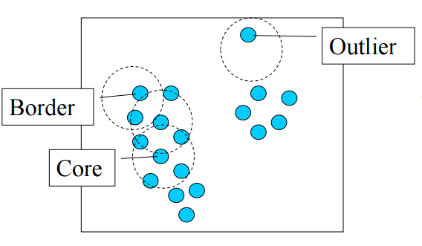
Cluster Analysis
Centroid Based
DBSCAN
1. Determine the minimum number of points in a cluster (numPts) and the radius of our neighborhoods around a data point p (eps).
Connectivity Based
Distribution Based
Density Based

Slide 19
Cluster Analysis
Centroid Based
DBSCAN
2. Search for a random point having at least numPts inside a radius eps. If found, define as a core point.
Connectivity Based
Distribution Based
Density Based

Slide 20
Cluster Analysis
DBSCAN
3. Search for new random points not in a cluster having at least numPts inside a radius eps. When found all the core points, expand to the border points. Points that are not included are defined as outliers
Centroid Based
Connectivity Based
Distribution Based
Density Based

Slide 21
Cluster Analysis
Centroid Based
Density-Based Spatial
Clustering of Applications
with Noise (DBSCAN)
Advantages:
Does not require the number of clusters as a parameter.
Discovery of clusters with arbitrary shape.
Ability to handle outliers (resistant to noise)
Connectivity Based
Distribution Based
Density Based

Slide 22
Cluster Analysis
Density-Based Spatial
Clustering of Applications
with Noise (DBSCAN)
Disadvantages:
If there is variation in the density, noise points are not detected
Sensitive to parameters (hard to determine the correct set of parameters)
The quality of DBSCAN depends on the distance measure.
DBSCAN cannot cluster data sets well with large differences in densities.
Centroid Based
Connectivity Based
Distribution Based
Density Based

Slide 23
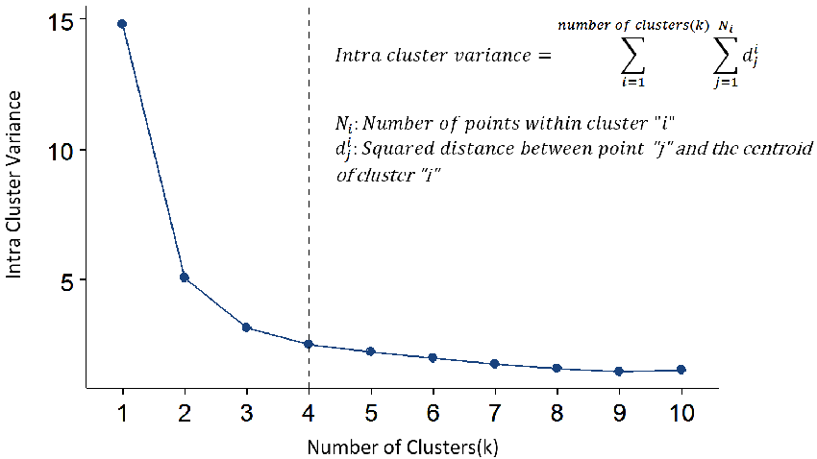
Calculating Cluster Numbers
Finding the optimal number of clusters for our data:
Empirical method: k ≈ √n/2
Elbow method: using a graph with the number of clusters (x-axis) and the sum of the within cluster variance.

Slide 24
Calculating Cluster Numbers
In R we have the NbClust package which provide 30 different indices that are used to recommend the optimal number of clusters for our data.
## Among all indices:
## ===================
## * 2 proposed 0 as the best number of clusters
## * 1 proposed 1 as the best number of clusters
## * 9 proposed 2 as the best number of clusters
## * 4 proposed 3 as the best number of clusters
## * 6 proposed 4 as the best number of clusters
## * 2 proposed 5 as the best number of clusters
## * 1 proposed 8 as the best number of clusters
## * 1 proposed 10 as the best number of clusters
##
## Conclusion
## =========================
## * According to the majority rule, the best number of clusters is 2 .

Slide 25
Cluster Evaluation
Cluster Evaluation
Avoid finding patterns in noise
Compare cluster algorithms
Compare clusters with different k to determine the optimal number of clusters
Compare the clusters
Types:
Internal validation (use the data to check how well clusters are separated)
External validation (use other data to check how the clusters behave)

Slide 26
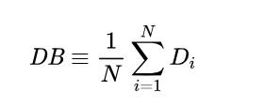
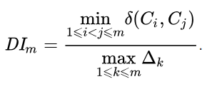

Cluster Evaluation
Internal Evaluation
Aim: is to identify sets of clusters that are compact, with a small variance between members of the cluster, and well separated, where the means of different clusters are sufficiently far apart, as compared to the within cluster variance
Davies–Bouldin index Lower is better
Dunn index Higher is better
Silhouette coefficient Higher is better

Slide 27
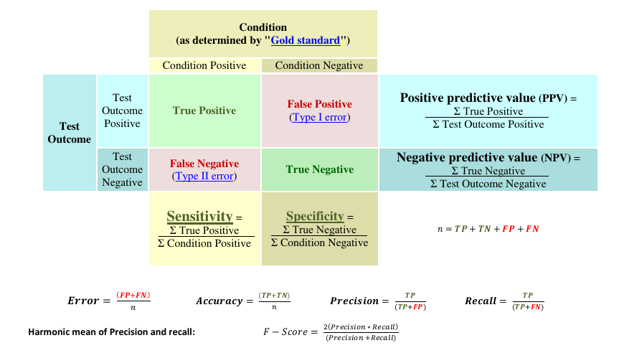
Cluster Evaluation

Slide 28
Cluster Evaluation
External Evaluation
Entropy based measures
Mutual information
Pairwise measures
Confusion matrix ( TP,TN,FP,FN )
Jaccard index [ TP/(TP+FP+FN) ]
Rand measure [ TP+TN/(TP+FP+FN+TN) ]
Fowlkes–Mallows index [ TP/√((TP+FP)(TP+FN)) ]
Matching based measures
Purity (% of correctly classified objects)
F-measure [ 2*precision*recall/(precision + recall) ]

Slide 29
Unsupervised Learning
Principal Component Analysis (PCA)
A dimensional-reduction tool that can be used to reduce a large set of variables to a small set that still contains most of the information in the large set.
Uses mathematical transformation (orthogonal) that transforms a number of (possibly) correlated variables into a (smaller) number of uncorrelated variables called principal components.

Slide 30
Unsupervised Learning
Principal Component Analysis (PCA)
The first principal component accounts for as much of the variability in the data as possible, and each succeeding component accounts for as much of the remaining variability as possible.
We can use PCA to select a subset of variables from a larger set, based on which original variables have the highest correlations with the principal component.

Slide 31
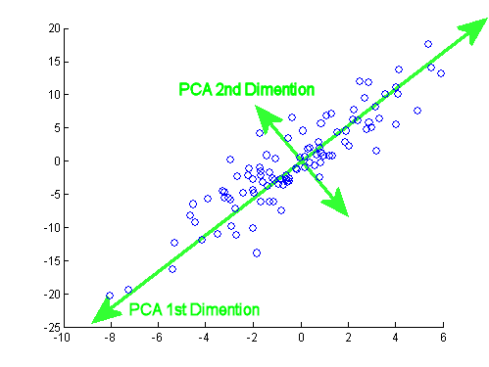
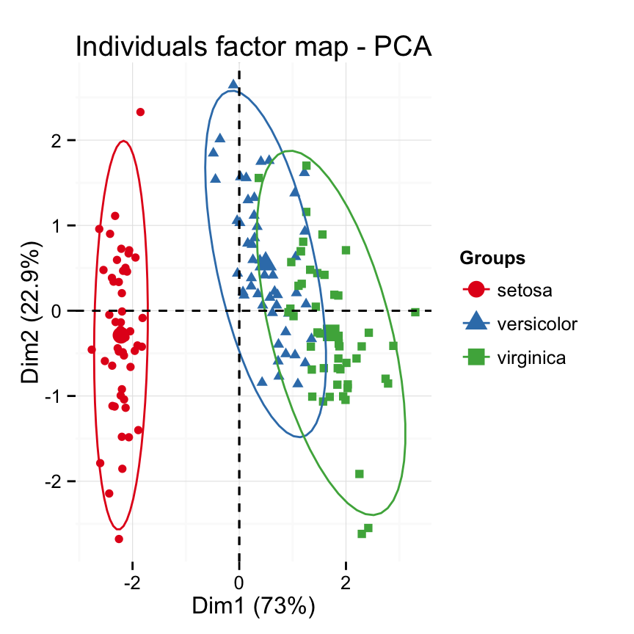
Unsupervised Learning
Principal Component Analysis (PCA)

